Slide 1
DIABETES PREDICTION
USING MACHINE LEARNING ALGORITHMS
MENTOR: P.CHARAN ASST. PROF
D. Praveen – Y19CS3210
G. Jahnavi – Y19CS3215
S. Vamsi -LT20CS3275

Slide 2
ABSTRACT
Diabetes is a chronic disease with the potential to cause a worldwide health care crisis.
According to International Diabetes Federation 382 million people are living with diabetes across the whole world.
Diabetes is a disease caused due to the increase level of blood glucose.
Early prediction of diabetes is quite challenging task but using machine learning algorithms we can deal these medical problems.
The aim of this project is to develop a system which can perform early prediction of diabetes for a patient with a higher accuracy by combining the results of different machine learning techniques.
we will explore how Random Forest classifier can be used for diabetes prediction.

Slide 3
AGENDA:
1. Introduction
2. Understanding diabetes
3. Machine learning for diabetes prediction
4. Dataset
5. Data Preprocessing
6. Training and testing the model
7. Choose Machine learning Models
8. Interpreting the results(accuracy prediction)
9. Understanding random forest classifier
10. User interface using Python
11. Result
12. Conclusion

Slide 4
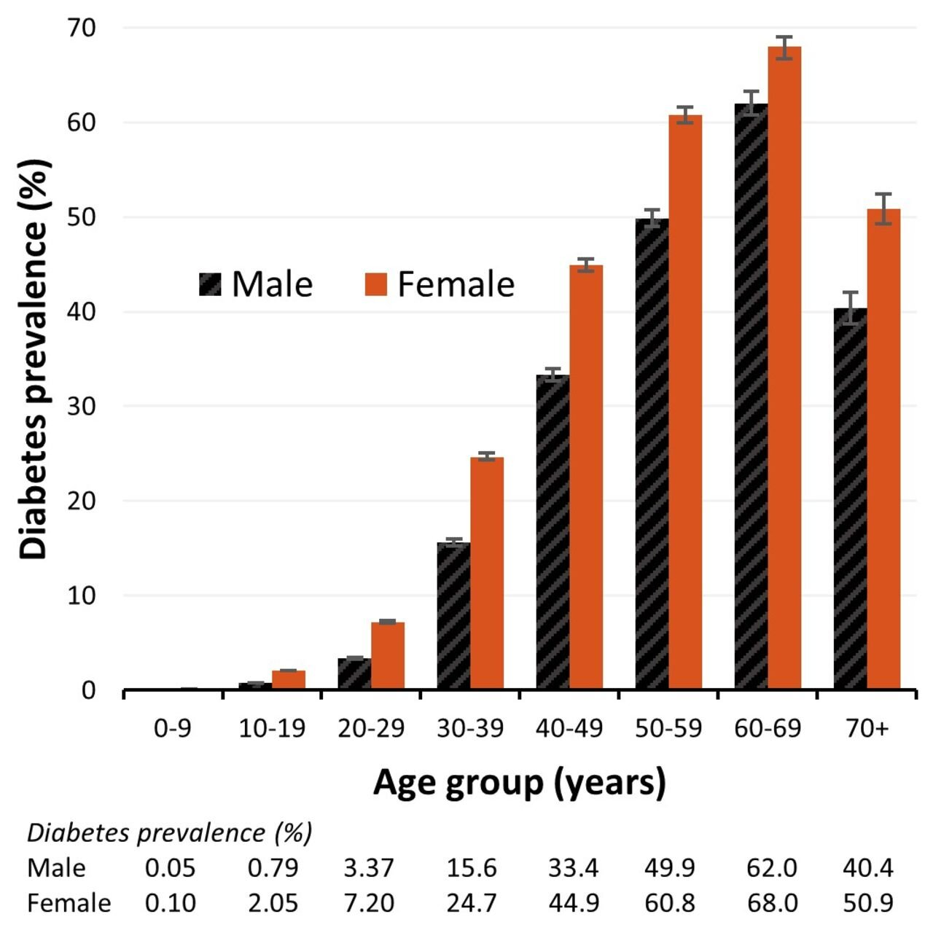
INTRODUCTION
Diabetes is a chronic disease that affects millions of people worldwide. It is characterized by high levels of sugar in the blood, which can lead to serious health complications over time.
Machine learning algorithms have shown promising results in predicting diabetes.

Slide 5
TECHNOLOGIES AND LIBRARIES USED
JUPYTER NOTEBOOK
PYTHON LIBRARIES :
PANDAS
NUMPY
MATPLOTLIB
SKLEARN
PICKEL

Slide 6
UNDERSTANDNG DIABETES
Diabetes is a metabolic disorder characterized by high blood glucose levels. There are two main types of diabetes: type 1 and type 2.
Type 1 diabetes is an autoimmune disease that occurs when the body's immune system attacks and destroys insulin-producing cells in the pancreas.
Type 2 diabetes, on the other hand, is caused by a combination of genetic and lifestyle factors.
Diabetes can lead to a range of complications such as heart disease, kidney failure, and blindness. Early detection and management of diabetes can help prevent these complications.

Slide 7
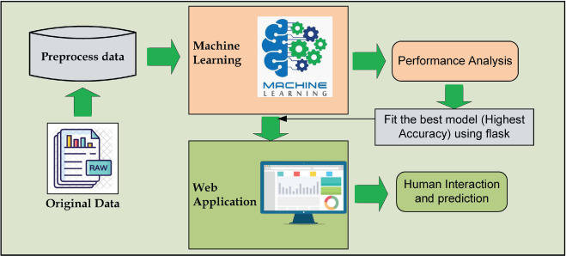
Machine Learning for diabetes prediction
Machine learning algorithms can be trained on large datasets of patient information to predict the likelihood of developing diabetes. These algorithms use various features such as age, body mass index, blood pressure, and glucose levels to make predictions.
Several studies have shown that machine learning algorithms can outperform traditional statistical models in predicting diabetes. This has the potential to improve early detection and prevention of diabetes.

Slide 8
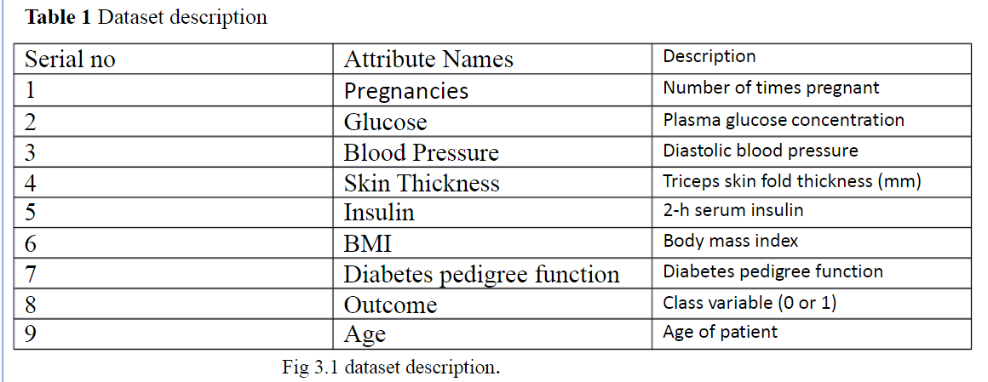
DATA SET
The dataset collected is originally from Kaggle. It consists of several medical analyst variables and one target variable. The objective of the dataset is to predict whether the patient has diabetes or not. The dataset consists of several independent variables and one dependent variable, i.e., the outcome.

Slide 9
Data Preprocessing
Before applying the Machine Learning classifier to predict diabetes, we need to preprocess the data. This involves :
Cleaning the data :
Cleaning the data involves removing any duplicates or irrelevant information.
Handling missing values :
Handling missing values can be done by imputing them with the mean or median value of the feature
Scaling the features :
Scaling the features is important because it ensures that all features are on the same scale, making it easier for the algorithm to learn from them
Data visualization :
Heatmap, Histograms

Slide 10
Training and Testing the model
Once the data has been preprocessed, we can split it into training and testing sets. We are split training and testing the data in 7:3 ratio.
The training set is used to train the ML classifier, while the testing set is used to evaluate its performance.
To assess the performance of the model, we can use metrics such as accuracy, precision, recall, and F1 score. These metrics give us an idea of how well the model is able to predict diabetes based on the given features.

Slide 11
Choose machine Learning Models
We have developed a model using Machine learning Technique. Used different classifier and ensemble techniques to predict diabetes dataset. We have applied SVM, Logistic regression, Decision Trees and Random Forest. Machine learning classifier to analyze the performance by finding accuracy of each classifier. All the classifiers are implemented using Sklearn libraries in python.
1. LOGISTIC REGRESSION:
Logistic regression is a machine learning technique used when dependent variables are able to categorize. The outputs obtained by using the logistic regression is based on the available features.

Slide 12
2. DECISION TREES:
Decision tree is non parametric classifier in supervised learning. In this method all the details are represented in the form of tree, where leaves are corresponds to the class labels and attributes are corresponds to internal node of the tree. We have used Gini Index for splitting nodes
3. SUPPORT VECTOR MACHINE:
SVM is supervised learning algorithm used for classification. In SVM we have to identify the right hyper plane to classify the data correctly. In this we have to set correct parameters values. To find the right hyper plane we have to find right margin for this we have choose the gamma value as 0.0001 and rbf kernel. If we select the hyper plane with low margin leads to miss classification.
4. RANDOM FOREST:
Random forest is an ensemble learning method for classification. This algorithm consists of trees and the number of tree structures present in the data is used to predict the accuracy. Where leaves are corresponds to the class labels and attributes are corresponds to internal node of the tree. Here number of trees in forest used is 100 in number and Gini index is used for splitting the nodes

Slide 13
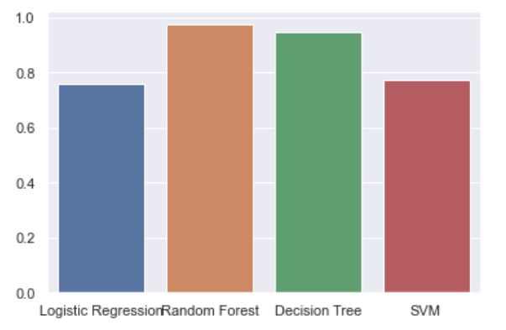
Interpreting the results(Accuracy Prediction)
Accuracy results of these 4ML algorithms are after training and prediction on algorithm is
Algorithm Accuracy score
Logistic regression 0.74
Decision tree 0.94
SVM 0.77
Random forest 0.95
Among all these Random Forest Algorithm is best for training, predicting and give best accuracy score.
So, after predicting input data with training set we use random forest algorithm for best accuracy.

Slide 14
Understanding Random Forest Classifier
Random forest classifier is a machine learning algorithm that uses an ensemble of decision trees to make predictions. It works by creating multiple decision trees on randomly selected subsets of the data and then combining their results to make a final prediction.
The advantage of using a random forest classifier is that it can handle large datasets with many features and still maintain high accuracy. It also reduces the risk of overfitting, which occurs when a model is too complex and fits the training data too closely, resulting in poor performance on new data.

Slide 15
User interface using Python(pyqt5)
There are so many options provided by Python to develop GUI applications and PyQt5 is one of them. PyQt5 is a cross-platform GUI toolkit, a set of Python bindings for Qt v5.
A GUI application consists of Front-end and Back-end.
PyQt5 has provided a tool called ‘QtDesigner’ to design the front-end by drag and drop method so that development can become faster and one can give more time on back-end stuff.
Entering attribute values in this format
Pregnancies: 0-3 Glucose:70-180ml BMI:10-50
Insulin:15-276m/u DPF: 0-5 Age:0-100
Skin thickness: 10-50 mm Blood Pressure:80-140mm

Slide 16
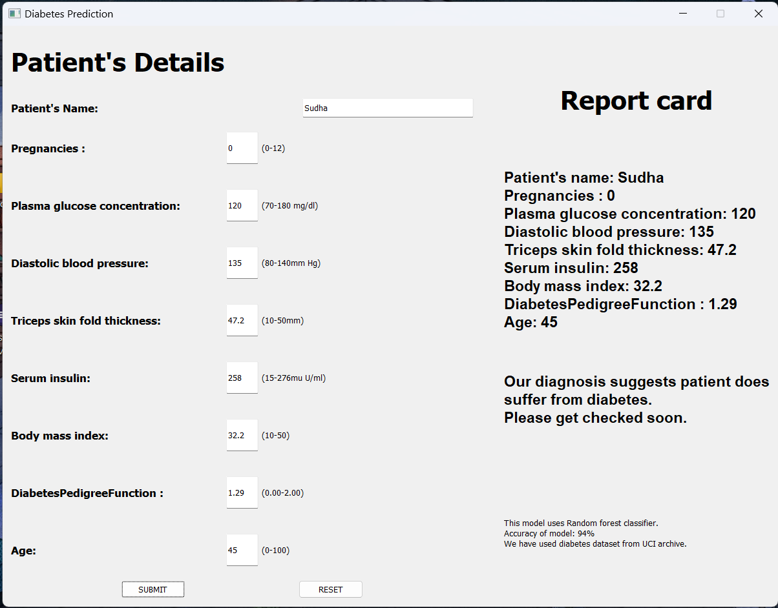

Slide 17
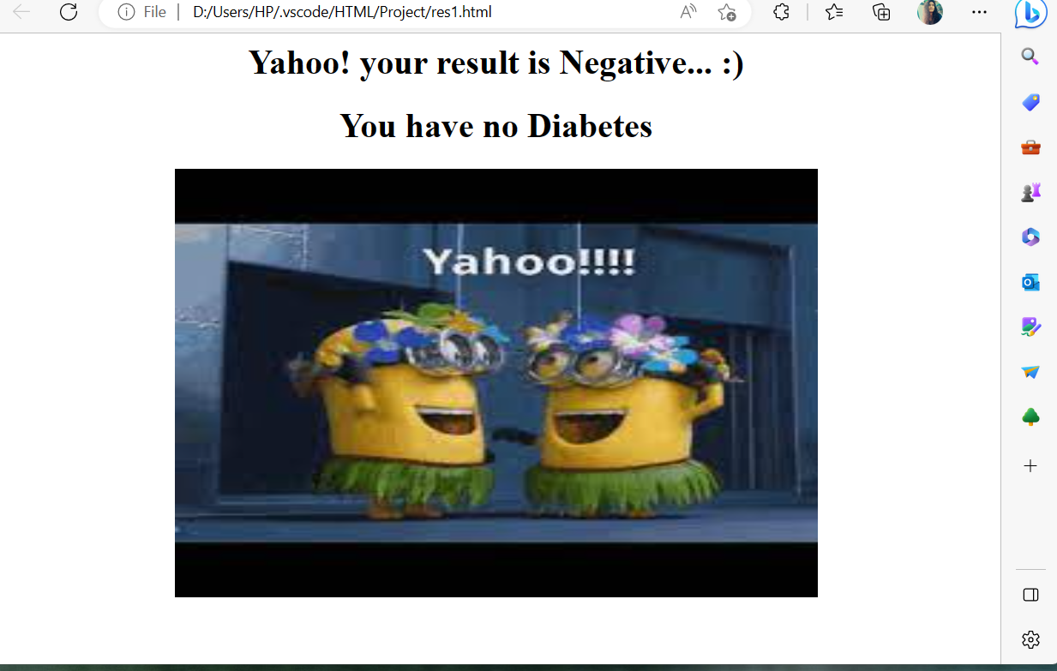
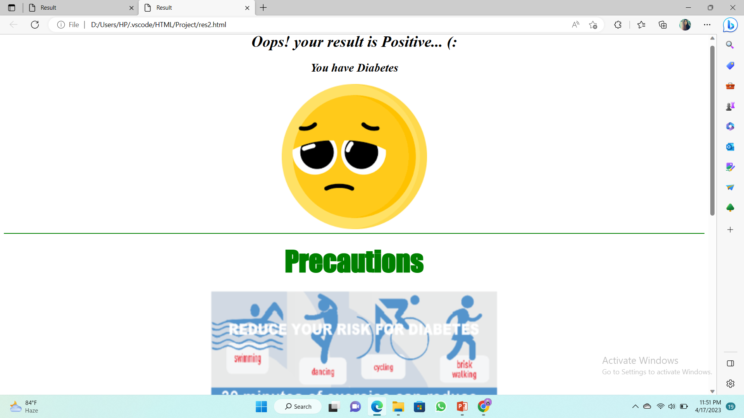
Result
If result is Negative we shown this image
If result is Positive we shown this image

Slide 18
Conclusion
Machine learning has the potential to revolutionize diabetes prediction and management. By leveraging large datasets and advanced algorithms, we can improve early detection and prevention of diabetes, leading to better patient outcomes.
In conclusion, random forest classifier is a powerful machine learning algorithm that can be used for diabetes prediction. By preprocessing the data, training and testing the model, and interpreting the results, we can gain valuable insights into the factors that contribute to diabetes and develop effective strategies for prevention and management.

Slide 19
THANK YOU

